Slide 1
Copyright Treasure Hunt
By: Brandon Smith
Educational Application of Technology

Slide 2
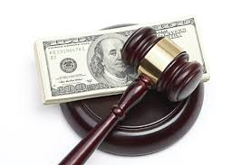
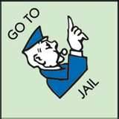
What is the penalty for copyright infringement?
Penalties for copyright infringement include civil and criminal penalties. In general, anyone found liable for civil copyright infringement may be ordered to pay either actual damages or "statutory" damages affixed at not less than $750 and not more than $30,000 per work infringed. For "willful" infringement, a court may award up to $150,000 per work infringed. A court can, in its discretion, also assess costs and attorneys' fees. For details, see Title 17, United States Code, Sections 504, 505.
Willful copyright infringement can also result in criminal penalties, including imprisonment of up to five years and fines of up to $250,000 per offense.

Slide 3
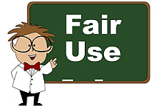

Slide 4
What does the term “fair use” mean and who is included in the fair use clause?
Fair use is a copyright principle based on the belief that the public is entitled to freely use portions of copyrighted materials for purposes of commentary and criticism. For example, if you wish to criticize a novelist, you should have the freedom to quote a portion of the novelist’s work without asking permission.
In its most general sense, a fair use is any copying of copyrighted material done for a limited and “transformative” purpose, such as to comment upon, criticize, or parody a copyrighted work. Such uses can be done without permission from the copyright owner. In other words, fair use is a defense against a claim of copyright infringement. If your use qualifies as a fair use, then it would not be considered an illegal infringement.

Slide 5
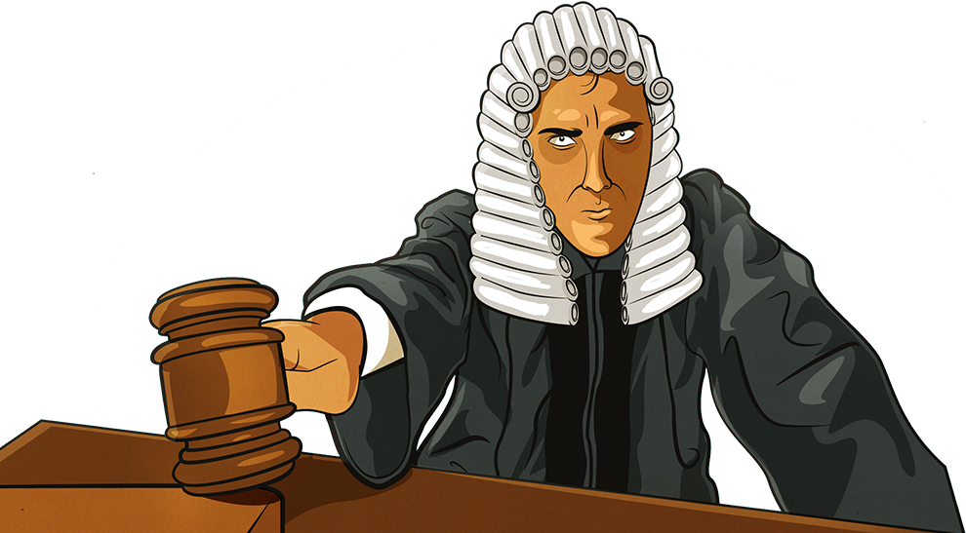
What are the conditions for deciding fair use?
The four factors judges consider are:
the purpose and character of your use
the nature of the copyrighted work
the amount and substantiality of the portion taken, and
the effect of the use upon the potential market.

Slide 6
When using multimedia in the classroom, what kinds of things need to be considered when determining whether copyright has been adhered to?
To determine whether copyright has been adhered to, the user must;
Make sure that all materials are following copyright laws with restrictions for further use
Make sure it follows fair use guidelines
Make sure that there is fair use to the copyright
Must be aware where fair use ends
Must make sure that the work was properly credited and cited

Slide 7
What are the conditions for using someone else’s words?
Educators and students must credit sources, giving full bibliographic information when available; must also display the copyright notice and copyright ownership information if this is shown in the original source.
Up to 10% of a copyrighted work or 1000 words, whichever is less
Poems
Entire poem if less than 250 words
250 words or less if longer poem
No more than 5 poems (or excerpts) of different poets, from an anthology
Only 3 poems (or excerpts) per poet

Slide 8
What are the conditions for using another’s musical score?
Teachers are allowed to use another’s musical score if;
Only up to 10% of a copyrighted musical composition, but no more than 30 seconds is used;
Up to 10% of a body of sound recording, but no more than 30 seconds is used;
Any alterations cannot change the basic melody or the fundamental character of the work.

Slide 9
What are the guidelines for using film in the classroom?
Teachers are allowed to use films in their classrooms but they have to adhere to the following guidelines;
They are only allowed to use up to 10% of a copyrighted work or 3 minutes, whichever is less;
Clip cannot be altered in any way.

Slide 10
What if you want to tape something off the TV to use in the classroom…What are the rules here?
Educators are allowed to tape/record programs from the TV, however;
You are only allowed to record up to 10% of a copyrighted work and/or three minutes, whichever is less; clips cannot be altered in any way.

Slide 11
How can you get permission to use items in your classroom?
Educators can gain permission to use items in their classrooms by doing the following;
Identify the author(s) and contact one or more of them
Ask whether they own the copyright or whether the work was work for hire
Ask whether they have conveyed away any of their rights, and if so, to whom

Slide 12
When items are posted to a website what should the creator be careful to consider?
Whenever an author posts anything on the internet, he or she should reasonably expect that it will be read, downloaded, printed out, forwarded, and even used as the basis for other works to some degree. So, just by posting, an author impliedly grants a limited license to use her work in this manner.

